Slide 1
Diagnosis of cardiac diseases by robust-feature selection from the complex latent space of DL-based segmentation networks.
Fahim Ahmed Zaman
Wahidul Alam
Dec 07, 2022

Slide 2
Project Goal
Takotsubo Syndrome (TTS)
ST-elevation myocardial infarction (STEMI)
Control (CTRL)

Slide 3
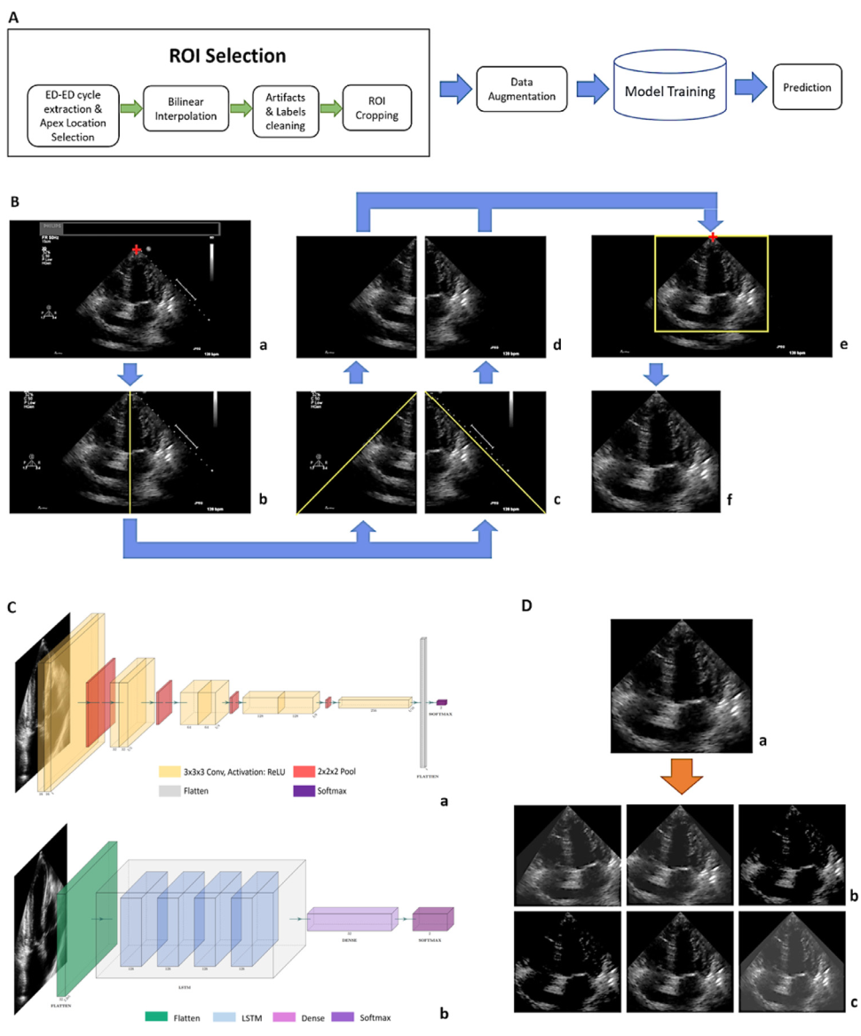
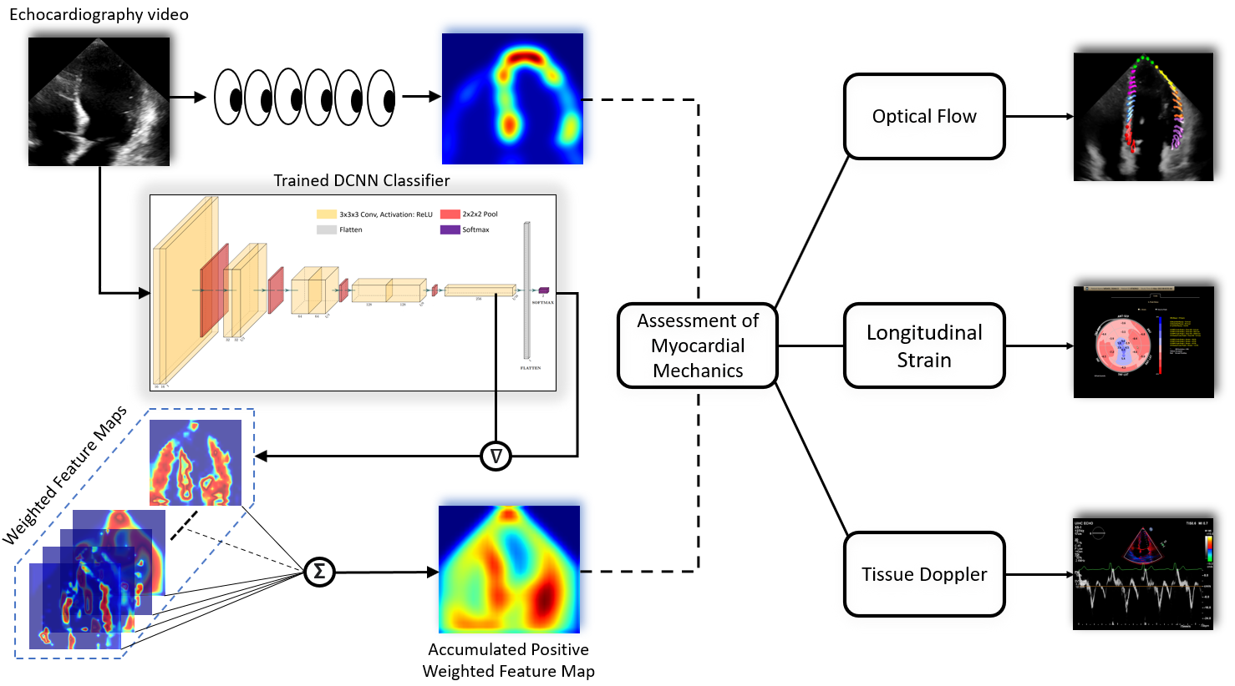
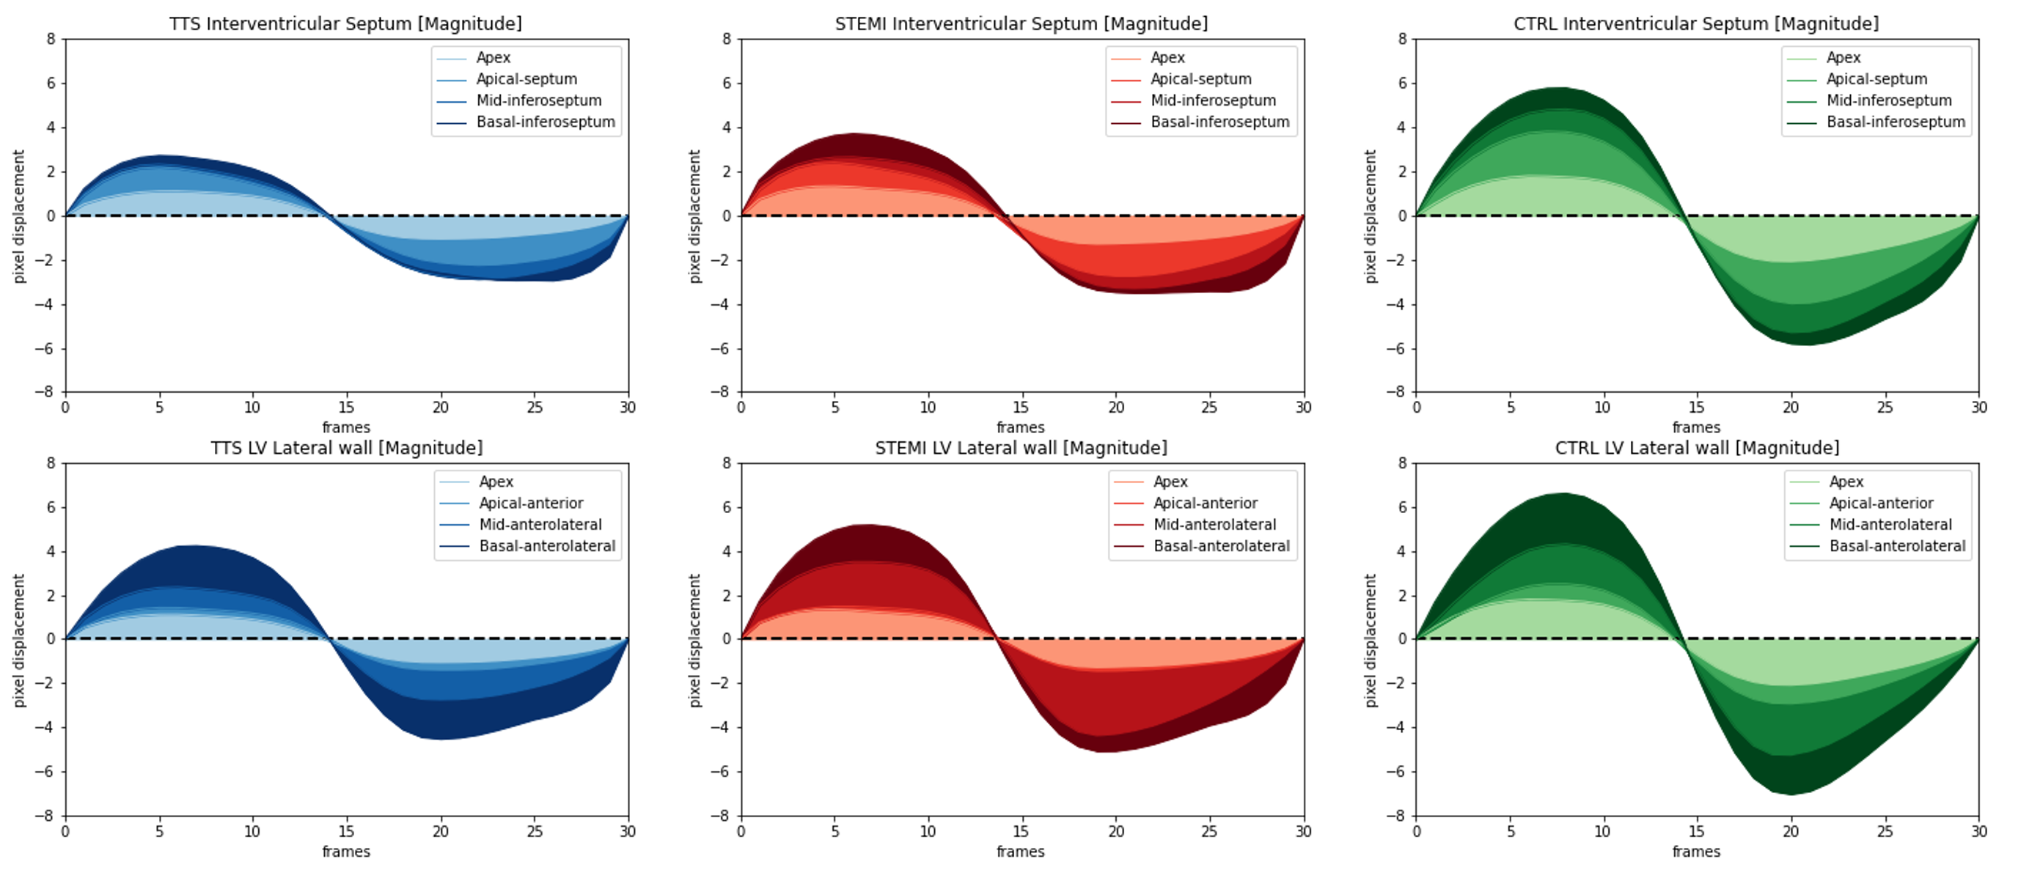
Previous Works and Motivation
Physicians
Machine
80%
76%

Slide 4
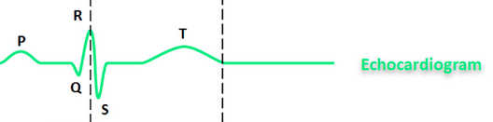
Dataset
Echocardiogram videos
TTS – 140
STEMI – 160
CTRL - 150
Frame rate – 12-75 frames/cardiac cycle (average: 32.4frames/cycle)
1 cardiac cycle – 1 diastolic phase + 1 systolic phase
Binary interpolation – 32 frames/cycle
Peak End Diastolic (ED)
Peak End Systolic (ES)

Slide 5
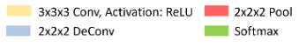
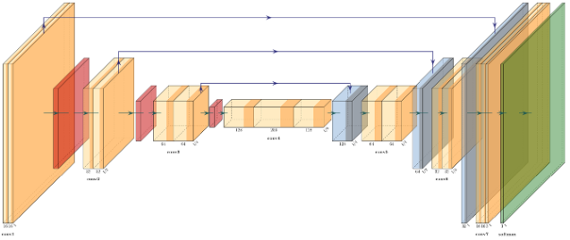
Methodology: Feature extraction
Echo
LV Segmentation
F₁
F₂
F₃
F_{N}
Flatten
1×3584

Slide 6
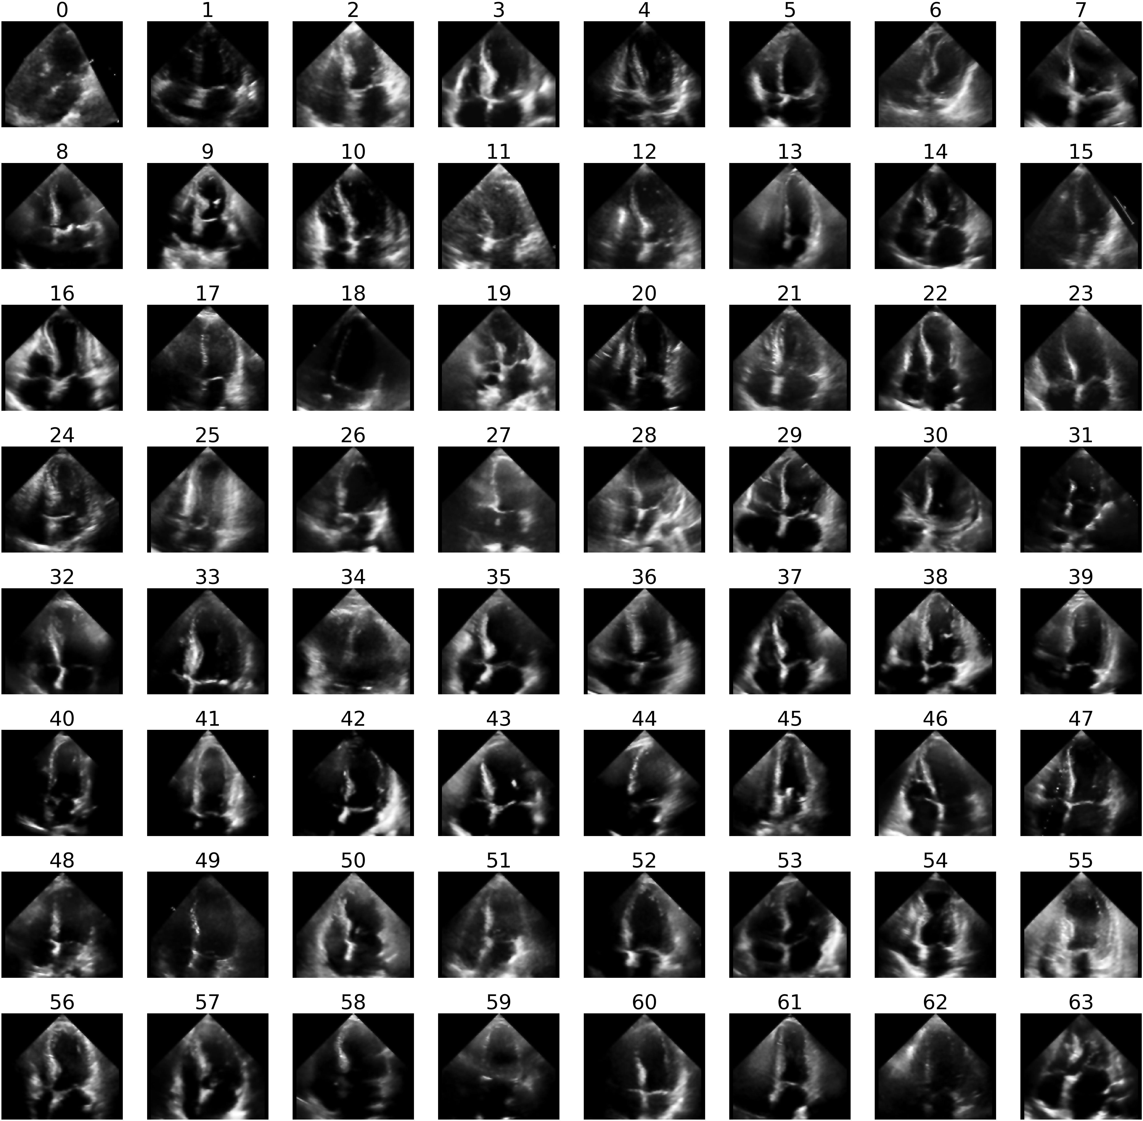
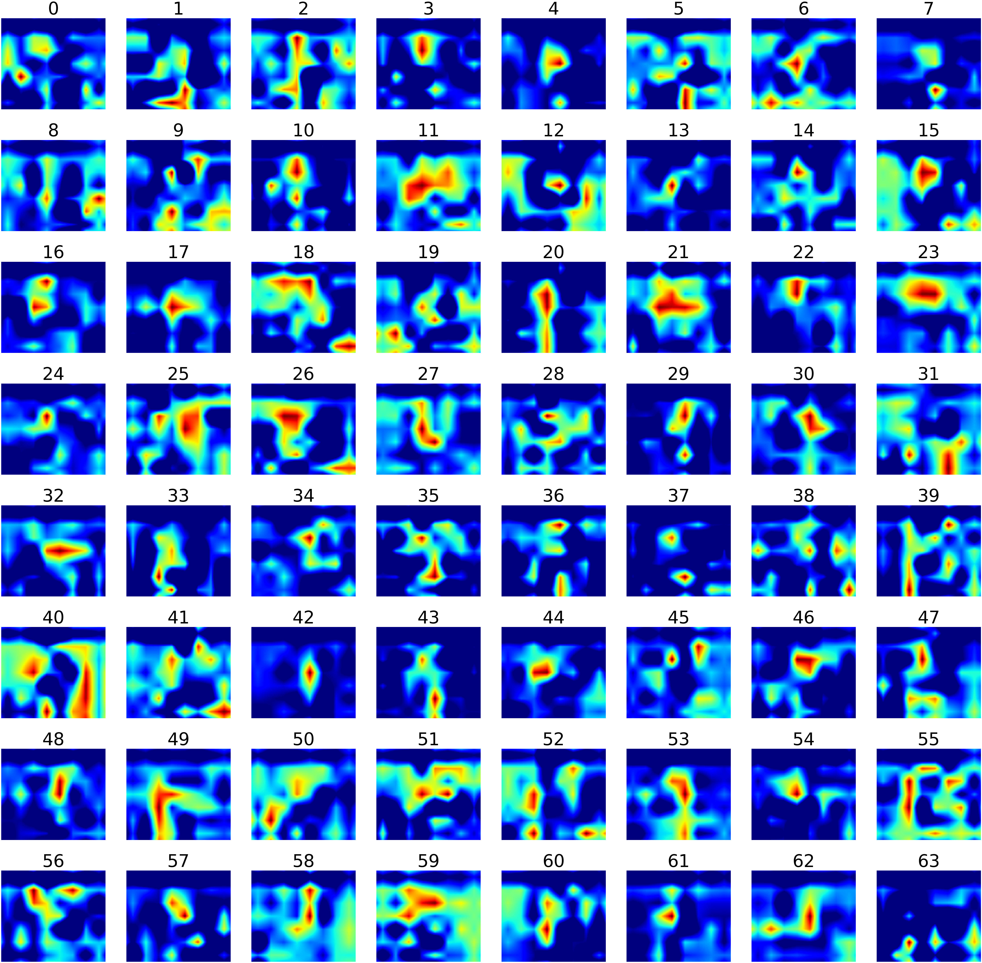
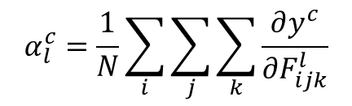
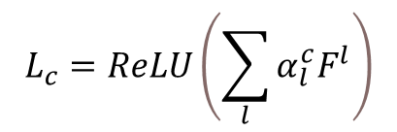
Methodology: Feature Reduction
$$α_{l}^{c}=\frac{1}{N}\sum_{i}{\sum_{j}{\sum_{k}{\frac{∂y^{c}}{∂F_{ijk}^{l}}}}}$$
$$L_{c}=ReLU\left(\sum_{l}{α_{l}^{c}F^{l}}\right)$$
Echo
GradCAM

Slide 7
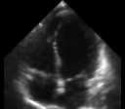
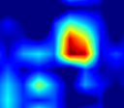
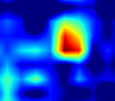
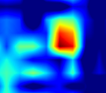
Methodology: Feature Reduction
3584
560
336
Echo
All features
5 highest weighted features
3 most frequent in 5 highest weighted features

Slide 8
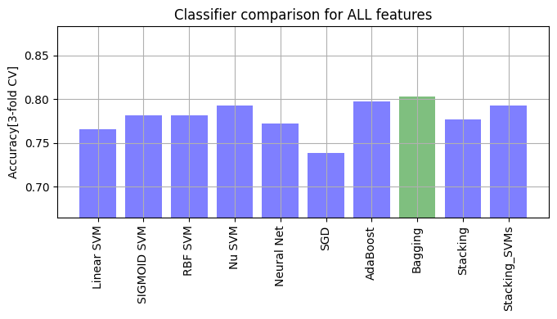
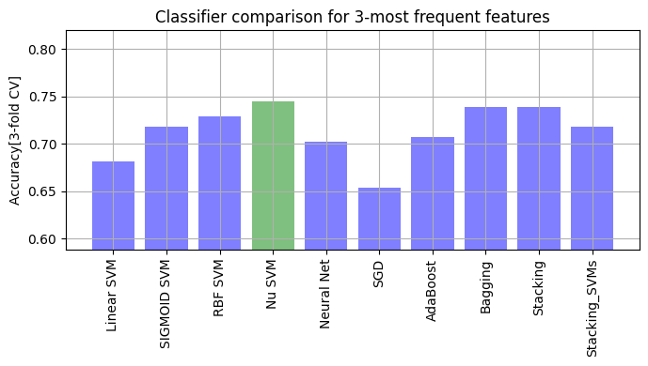
ML Evaluations

Slide 9
Conclusion
Same accuracy as the state-of-the-art approach using latent features
Acquisition of robust features
Redundant feature reduction
A significant step for disease prognostic prediction pipeline

Slide 10
Thank You

Slide 11
Questions?

